Slide 1
What's new in .NET 8 & C# 12
Why should you update to .NET 8?
CF .NET
Author: Anh Truong
Software development
Department: M-SDE-DD2

Slide 2
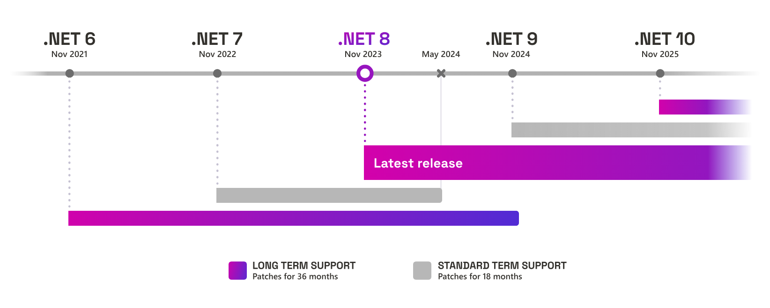
.NET release cadence
Source: Microsoft

Slide 3
.NET Runtime
Performance-related improvements
1250+
1000+
550+
250+
.NET 5
.NET 6
.NET 7
.NET 8

Slide 4
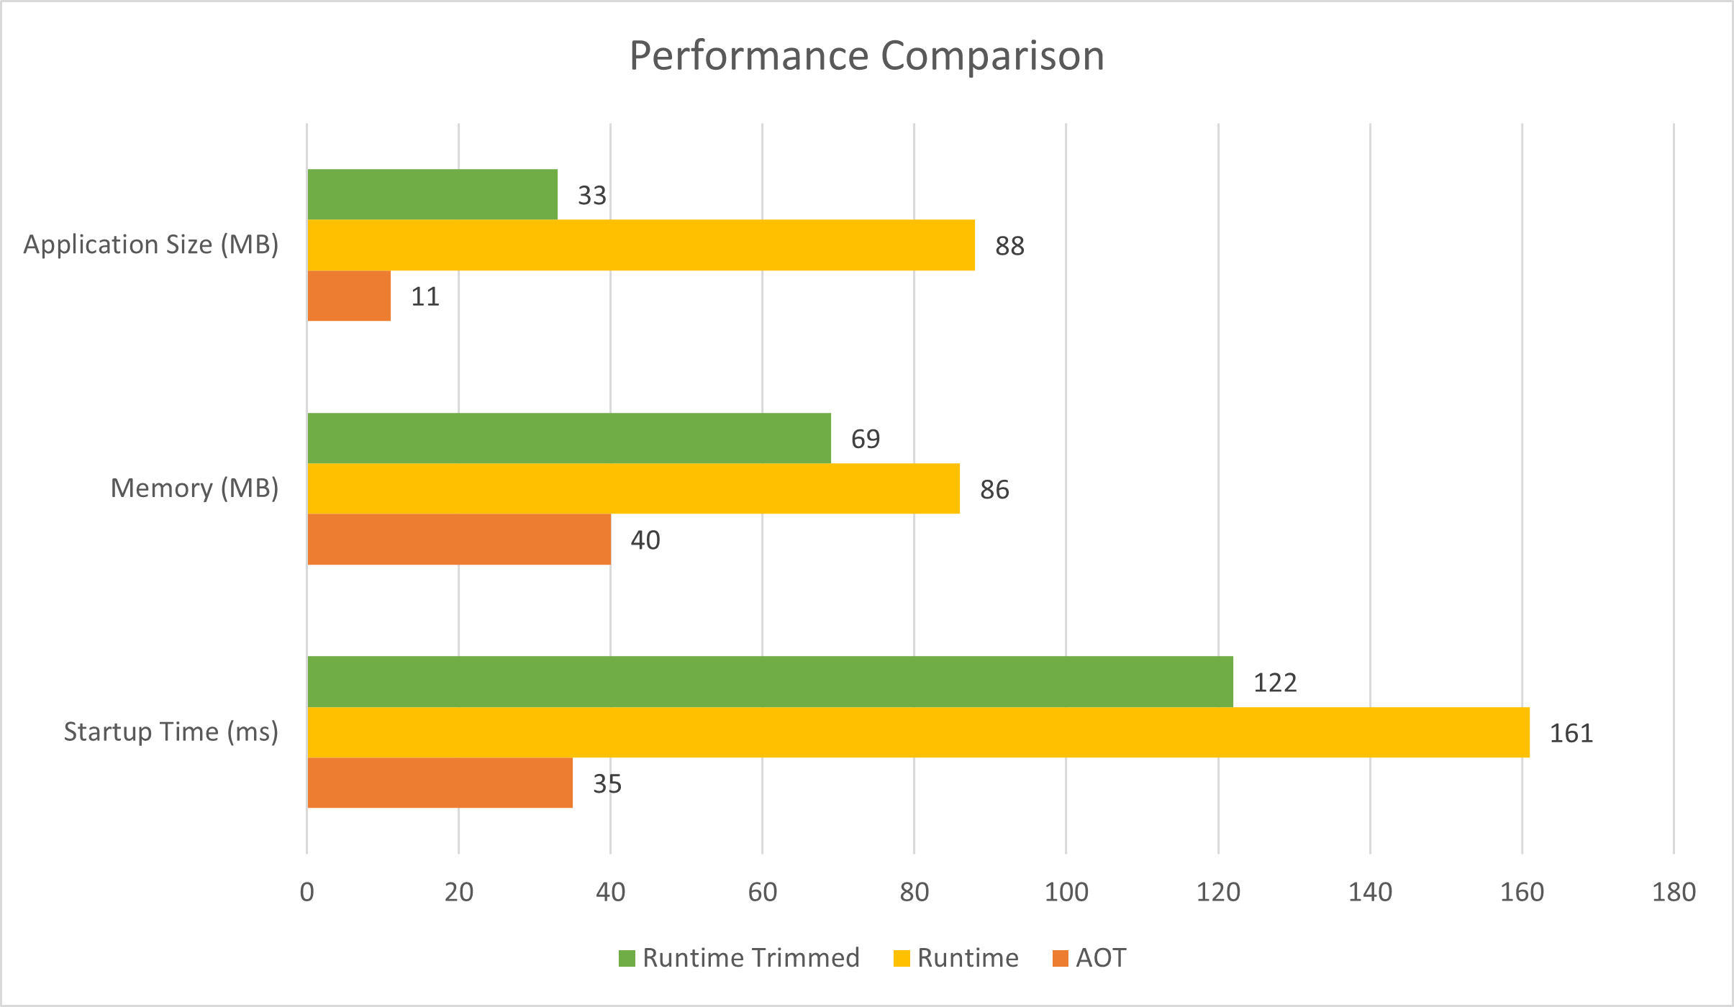
.NET Runtime
Native AOT
Source: Microsoft

Slide 5
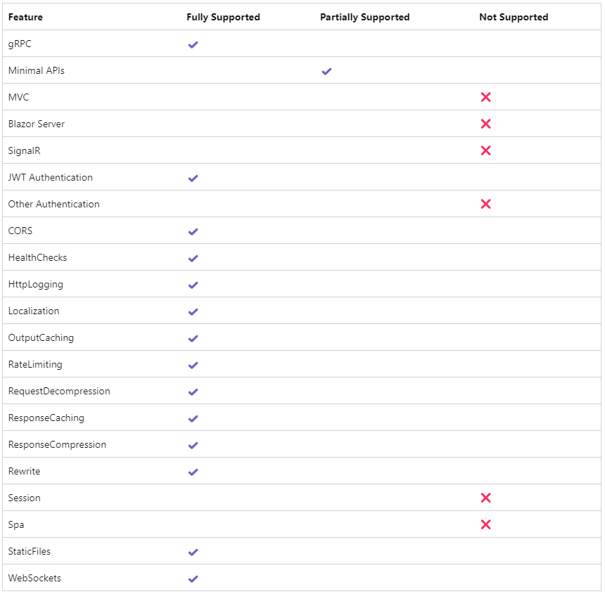
.NET Runtime
Native AOT - limitations
Compatibility issues:
Use of reflection to inspect and discover types.
Conditionally loading libraries at runtime.
Generating code on the fly to implement functionality.
…
For more infos:
Limitations of Native AOT deployment
Notes:
Suitable for console app, not big enterprise app
EF Core -> Dapper

Slide 6
.NET Runtime
System.Text.Json - Populate initialized properties
[JsonObjectCreationHandling(JsonObjectCreationHandling.Populate)]
class A
{
public List<int> Numbers1 { get; } = [1, 2, 3];
public List<int> Numbers2 { get; set; } = [1, 2, 3];
}
A? a = JsonSerializer.Deserialize<A>("""{"Numbers1": [4,5,6], "Numbers2": [4,5,6]}""");
// both Numbers1 and Numbers2 contain the values 1, 2, 3, 4, 5, and 6
// default: Numbers1 contains the values 1, 2, 3 and Numbers2 contains the values 4, 5, 6
Note:
Read-only properties, Struct property (setters required!) - supported
Global preference: PreferredObjectCreationHandling = JsonObjectCreationHandling.Populate
Primary constuctors - unsupported!
Notes:
required/init

Slide 7
.NET Runtime
System.Text.Json - Streaming deserialization APIs
public async static void StreamingDeserialization()
{
const string RequestUri = "https://api.contoso.com/books";
using var client = new HttpClient();
IAsyncEnumerable<Book?> books = client.GetFromJsonAsAsyncEnumerable<Book>(RequestUri);
await foreach (Book? book in books)
{
Console.WriteLine($"Read book '{book?.title}'");
}
}
public record Book(int id, string title, string author, int publishedYear);
Source: Microsoft

Slide 8
.NET Runtime
Frozen collections
System.Collections.Frozen.FrozenDictionary<TKey, TValue>
System.Collections.Frozen.FrozenSet<TKey, TValue>
Method | Mean | Ration
ImmutableDictionary_Gets | 360.55 μs | 13.89
Dictionary_Gets | 39.43 μs | 1.52
FrozenDictionary_Gets | 25.95 μs | 1.00
Method | Mean | Ration
HashSet_Contains | 15.228 ns | 1.00
FrozenSet_Contains | 8.218 ns | 0.54
Measurement from (3)
Note:
Performance ~ by types
Initial cost ↑

Slide 9
.NET Runtime
Time abstraction - Problem
public class ServiceA
{
public async Task MethodA(CancellationToken cancellationToken)
{
DateTimeOffset utcNow = DateTimeOffset.UtcNow;
DateTimeOffset localNow = DateTimeOffset.Now;
await Task.Delay(TimeSpan.FromSeconds(3), cancellationToken);
await MethodB().WaitAsync(TimeSpan.FromSeconds(3));
long start = Stopwatch.GetTimestamp();
TimeSpan period = Stopwatch.GetElapsedTime(start);
}
}
Notes:
Unit test?

Slide 10
.NET Runtime
Time abstraction - Now
public class ServiceA (TimeProvider timeProvider)
{
public async Task MethodA(CancellationToken cancellationToken)
{
DateTimeOffset utcNow = timeProvider.GetUtcNow();
DateTimeOffset localNow = timeProvider.GetLocalNow();
await Task.Delay(TimeSpan.FromSeconds(3), timeProvider, cancellationToken);
await MethodB().WaitAsync(TimeSpan.FromSeconds(3), timeProvider);
long start = timeProvider.GetTimestamp();
TimeSpan period = timeProvider.GetElapsedTime(start);
}
}

Slide 11
.NET Runtime
Randomness
var items = Random.Shared.GetItems([1, 2, 3, 4, 5, 6, 7, 8], 5);
// items: int[5] [3, 8, 1, 5, 1]
Random.Shared.Shuffle(items);
// items: int[5] [5, 1, 1, 3, 8]

Slide 12
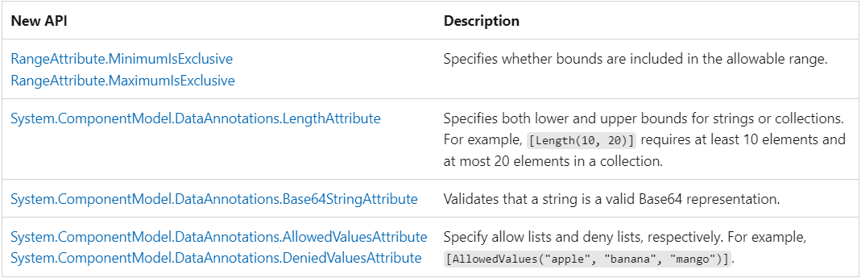
.NET Runtime
Data validation
Source: Microsoft

Slide 13
.NET Runtime
Garbage collection
DATAS - Dynamic adaptation to application sizes
Adjusts Heap Size Based on Workload,
Sets the actual amount of allocations allowed based on throughput,
Adjusts the number of heaps when needed, starts with one heap,
When needed, it does full-compacting GCs
Enabled by default - can be disabled
Notes:
.NET 8 adds a capability to adjust the memory limit on the fly

Slide 14
.NET Runtime
UnsafeAccessor
public class Service
{
[UnsafeAccessor(UnsafeAccessorKind.Field, Name = "_privateField")]
public static extern ref string GetSetPrivateField(Example example);
[UnsafeAccessor(UnsafeAccessorKind.Method, Name = "PrivateMethod")]
public static extern string GetPrivateMethod(Example example);
}
...
ref string privateField = ref Service.GetSetPrivateField(example);
var privateMethod = Service.GetPrivateMethod(example);
Notes:
.NET 8 adds a capability to adjust the memory limit on the fly

Slide 15
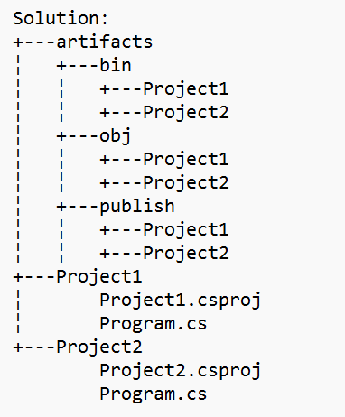
.NET SDK
New Features
CLI-based project evaluation
dotnet publish --getProperty:<PROPERTYNAME> (f. e. OutputPath)
dotnet publish --getItem:<ITEMTYPE> (f. e. ContainerImageTags)
Artifacts output layout
dotnet new buildprops --use-artifacts
Container publishing
Build multi-platform container images
Publish to tar.gz archive
Notes:
Artifacts: obj & bin folder

Slide 16
C# 12
New Features
Primary constructors
Collection expressions
ref readonly parameters
Default lambda parameters
Alias any type
Inline arrays
Experimental attribute
Interceptors*

Slide 17
C# 12
Primary constructors
internal class PrimaryConstructor(string name, int value)
{
public string Name { get; } = name;
public int Value { get; } = value;
}
internal class DependencyInjection(IService service)
{
public void Test()
{
service.Test();
}
}

Slide 18
C# 12
Collection expressions
char[] a = ['a', 'b', 'c', 'd', 'e', 'f'];
List<string> b = ["cdefhijk", "abcdefhij", "jk"];
Span<char> c = ['j', 'k'];
ReadOnlySpan<char> ic = [.. a, 'h', 'i', .. c];
int[][] twoD = [[1, 2, 3], [4, 5, 6], [7, 8, 9]];
int[] row0 = [1, 2, 3];
int[] row1 = [4, 5, 6];
int[] row2 = [7, 8, 9];
int[][] twoDFromVariables = [row0, row1, row2];
Dictionary<string, int> dict = [];

Slide 19
C# 12
ref readonly parameters
public void Test(ref int age)
{
age = 18;
Console.WriteLine($"The age is: {age}");
}
...
var age = 16;
RefReadonlyParameters.Test(ref age);
// The age is: 18

Slide 20
C# 12
ref readonly parameters
public void Test(ref readonly int age) // same as 'in int age’
{
age = 18; // compile error
Console.WriteLine($"The age is: {age}");
}
...
var age = 16;
RefReadonlyParameters.Test(ref age);
// The age is: 16
Notes:
C# added in parameters as a way to pass readonly references. in parameters allow both variables and values, and can be used without any annotation on arguments.
The addition of ref readonly parameters enables more clarity for APIs that might be using ref parameters or in parameters

Slide 21
C# 12
Default lambda parameters
var process = (string name = "default") =>
{
Console.WriteLine($"Running: {name} process...");
};
...
process(); // Running: default process...
process(“core"); // Running: core process...

Slide 22
C# 12
Alias any type
using Point3d = (int X, int Y, int Z); // alias any type
using List2d = List<List<ExtremeLongClassName>>;
...
Point3d point = (42, 43, 44);
point.Y = 0;

Slide 23
C# 12
Inline arrays
[System.Runtime.CompilerServices.InlineArray(8)]
internal struct Buffer
{
private byte _element0;
}
...
var buffer = new Buffer();
for (int i = 0; i < 8; i++)
{
buffer[i] = Convert.ToByte(i);
}
Notes:
Inline Arrays allow you to create an array of fixed size in a struct type. One advantage of this is that structs are value types, and memory for struct instances are usually allocated on the stack (unless subjected to ‘boxing,’ which is the process of converting a value type to a reference type, or if they are fields within a class or elements of an array), which results in more efficient memory usage, while arrays are reference types, and their memory is stored on the heap.

Slide 24
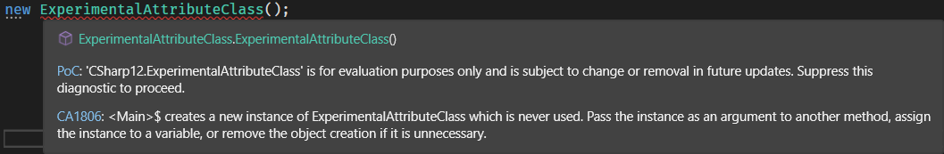
C# 12
Experimental attribute
[Experimental("PoC")]
public class ExperimentalAttributeClass { }
...

Slide 25
C# 12
Interceptors*
public class ExampleClass()
{
public static void Test()
{
Console.WriteLine($"Print from {nameof(ExampleClass)}.");
}
}
Notes:
Replace the method

Slide 26
C# 12
Interceptors*
[AttributeUsage(AttributeTargets.Method, AllowMultiple = true)]
public sealed class InterceptsLocationAttribute(string filePath, int line, int character) : Attribute { }
public static class Interceptors
{
[InterceptsLocation(filePath: "Program.cs", line: 14, character: 14)]
[InterceptsLocation(filePath: "Program.cs", line: 15, character: 14)]
public static void InterceptMethodTest()
{
Console.WriteLine("Replaced by Interceptor.");
}
}
Notes:
Replace code at compile time > source generator
You use an interceptor as part of a source generator to modify, rather than add code to an existing source compilation. The source generator substitutes calls to an interceptable method with a call to the interceptor method.

Slide 27
C# 12
Interceptors*
13
14
15
// Program.cs
...
ExampleClass.Test(); // Print from ExampleClass.
ExampleClass.Test(); // Replaced by Interceptor.
ExampleClass.Test(); // Replaced by Interceptor.
...
Ch. 14

Slide 28




.NET Aspire
Problems
Cloud Native project
Complex
Getting started
Choices
Paved Path

Slide 29
.NET Aspire
Overview
.NET Aspire is designed to enhance the development of .NET cloud-native applications by offering:
Orchestration:
Features for running and connecting multi-project applications.
Manages dependencies within local development environments.
Integrations:
NuGet packages for services such as Redis or Postgres.
Standardized interfaces for consistent and seamless connections with applications.
Tooling:
Project templates for Visual Studio, Visual Studio Code, and the .NET CLI.
Tooling experiences that facilitate the creation and management of .NET Aspire projects.
Notes:
The toolset provides support for Visual Studio 2022, .NET CLI, and Visual Studio Code. .NET Aspire is a collection of tools designed to simplify the development of cloud-native applications and increase productivity.

Slide 30
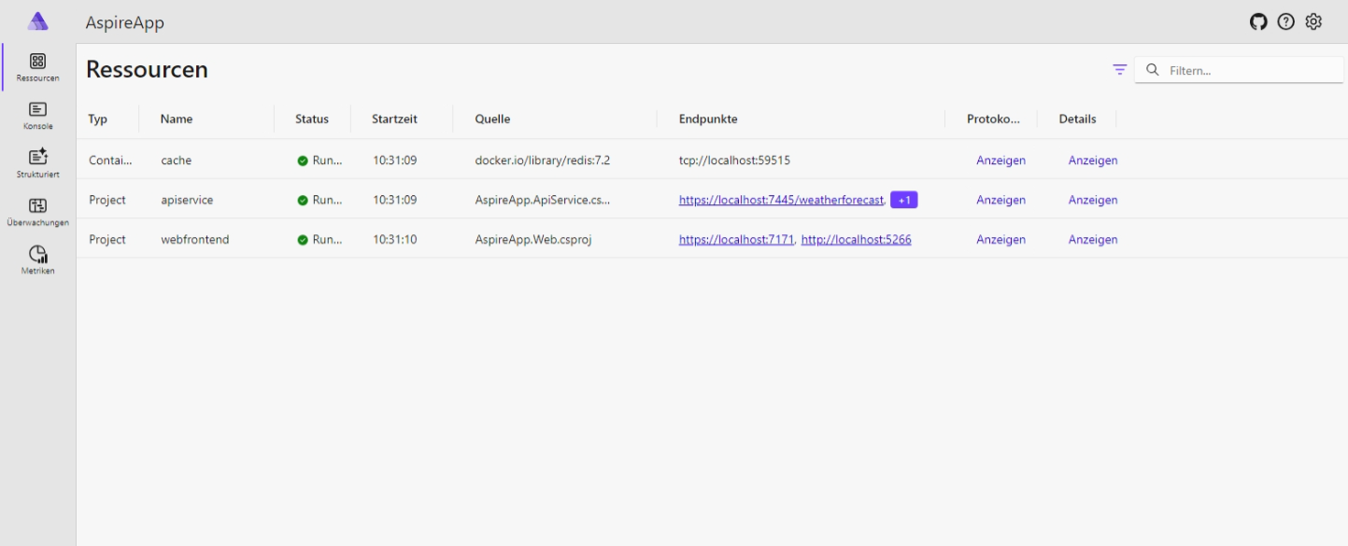
.NET Aspire
Developer Dashboard
Notes:
Components: redis, RabbitMQ, SQL Server, PostgreSQL, WebApps

Slide 31
.NET Aspire
Program.cs
var builder = DistributedApplication.CreateBuilder(args);
var cache = builder.AddRedis("cache");
var apiService = builder.AddProject<Projects.AspireApp_ApiService>("apiservice");
builder.AddProject<Projects.AspireApp_Web>("webfrontend")
.WithExternalHttpEndpoints()
.WithReference(cache)
.WithReference(apiService);
builder.Build().Run();
Notes:
Run in single command
Express application topology in C#
Deploy to the cloud

Slide 32
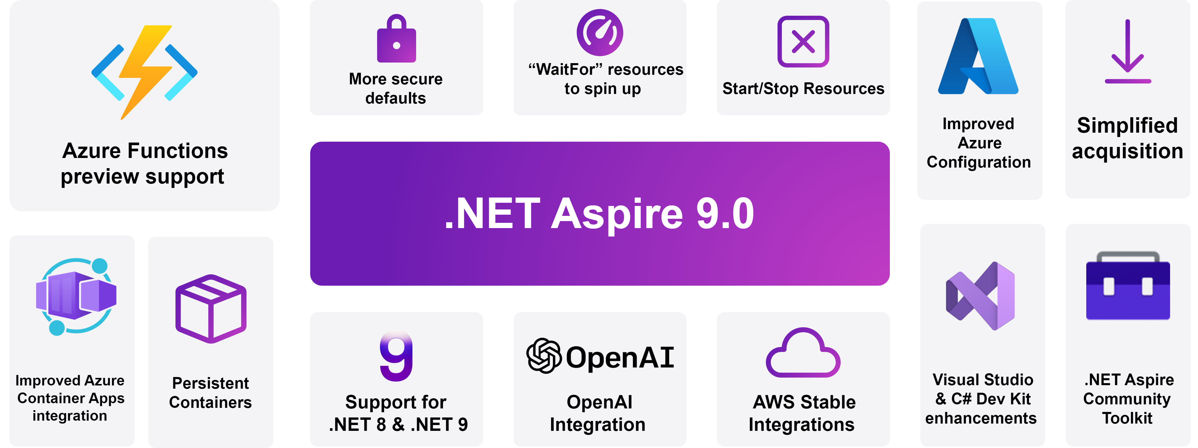
.NET Aspire
Program.cs
Source: Microsoft
Notes:
Official launch in .NET 9

Slide 33

ASP .NET Core

Slide 34

ASP .NET Core
New Features
Native AOT*
SignalR stateful reconnect
Identity API Endpoints
IAuthorizationRequirementData
Keyed DI services
Hosted lifecycle services
Support for generic attributes
Improved debugging experience
Short-circuit middleware

Slide 35
ASP .NET Core
SignalR stateful reconnect
// server hub endpoint
app.MapHub<MyHub>("/hubName", options =>
{
options.AllowStatefulReconnects = true;
});
// client code
var builder = new HubConnectionBuilder()
.WithUrl("<hub url>")
.WithStatefulReconnect();
builder.Services.Configure<HubConnectionOptions>(o => o.StatefulReconnectBufferSize = 1000);
var hubConnection = builder.Build();
Source: Microsoft
Notes:
Temporarily buffering data on the server and client.
Acknowledging messages received (ACK-ing) by both the server and client.
Recognizing when a connection is returning and replaying messages that might have been sent while the connection was down.

Slide 36
ASP .NET Core
Identity API endpoints
app.MapGroup("/identity").MapIdentityApi<IdentityUser>();
...
await httpClient.PostAsJsonAsync("/identity/register", new { username, password });
...
var loginResponse =
await httpClient.PostAsJsonAsync("/identity/login", new { username, password });
Notes:
MapIdentityApi<TUser> is a new extension method that adds two API endpoints (/register and /login). The main goal of the MapIdentityApi is to make it easy for developers to use ASP.NET Core Identity for authentication in JavaScript-based single page apps (SPA) or Blazor apps. Instead of using the default UI provided by ASP.NET Core Identity, which is based on Razor Pages, MapIdentityApi adds JSON API endpoints that are more suitable for SPA apps and nonbrowser apps.

Slide 37
ASP .NET Core
IAuthorizationRequirementData
[ApiController]
[Route("api/[controller]")]
public class GreetingsController : Controller
{
[MinimumAgeAuthorize(16)]
[HttpGet("hello")]
public string Hello(ClaimsPrincipal user) =>
$"Hello {(user.Identity?.Name ?? "world")}!";
}
Source: Microsoft
Notes:
Implementing an AuthorizeAttribute for each policy
Implementing an AuthorizationPolicyProvider to process a custom policy from a string-based contract
Implementing an AuthorizationRequirement for the policy
Implementing an AuthorizationHandler for each requirement

Slide 38
ASP .NET Core
IAuthorizationRequirementData
class MinimumAgeAuthorizeAttribute : AuthorizeAttribute, IAuthorizationRequirement, IAuthorizationRequirementData
{
...
}
class MinimumAgeAuthorizationHandler : AuthorizationHandler<MinimumAgeAuthorizeAttribute>
{
protected override Task HandleRequirementAsync(
AuthorizationHandlerContext context, MinimumAgeAuthorizeAttribute requirement)
{
...
}
}
Source: Microsoft

Slide 39
ASP .NET Core
Keyed DI services
builder.Services.AddKeyedTransient<IService, ServiceA>("serviceA");
builder.Services.AddKeyedTransient<IService, ServiceB>("serviceB");
app.MapGet("/service/a", (
[FromKeyedServices("serviceA")]IService service) =>
Results.Ok(service.Print));
app.MapGet("/service/b", (
[FromKeyedServices("serviceB")]IService service) =>
Results.Ok(service.Print));
Blazor:
[Inject(Key = "serviceA")] public IService Service { get; set; }

Slide 40
ASP .NET Core
IHostedLifecycleService
IHostedLifecycleService
StartingAsync(CancellationToken)
StartedAsync(CancellationToken)
StoppingAsync(CancellationToken)
StoppedAsync(CancellationToken)
Notes:
Hosted services now have more options for execution during the application lifecycle. IHostedService provided StartAsync and StopAsync, and now IHostedLifecycleService provides these additional methods:

Slide 41
ASP .NET Core
Support for generic attributes
[ApiController]
[Route("api/[controller]")]
public class TodosController : Controller
{
[HttpGet("/")]
- [ProducesResponseType(typeof(Todo), StatusCodes.Status200OK)]
+ [ProducesResponseType<Todo>(StatusCodes.Status200OK)]
public Todo Get() => new Todo(1, "Write a sample", DateTime.Now, false);
}
Notes:
[ProducesResponseType<T>]
[Produces<T>]
[MiddlewareFilter<T>]
[ModelBinder<T>]
[ModelMetadataType<T>]
[ServiceFilter<T>]
[TypeFilter<T>]

Slide 42
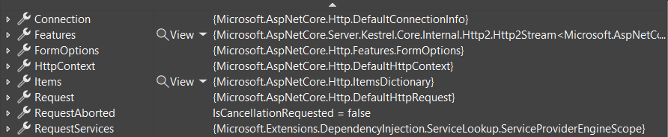
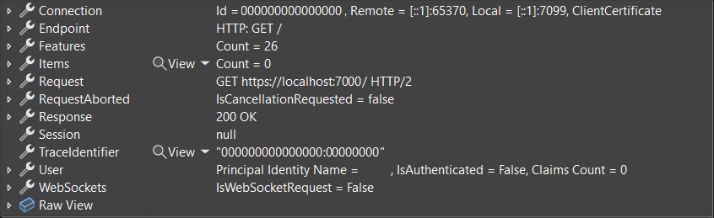
ASP .NET Core
Improved debugging experience
Source: Microsoft

Slide 43
ASP .NET Core
Short-circuit middleware
...
app.MapGet("/short-circuit", () => "Short circuiting!").ShortCircuit();
Notes:
Use the ShortCircuit extension method to cause routing to invoke the endpoint logic immediately and then end the request. For example, a given route might not need to go through authentication or CORS middleware.

Slide 44

ASP .NET Core
Minimal APIs
Binding to forms – [FromForm]
Antiforgery support
New Builder APIs
CreateSlimBuilder: minimum ASP.NET Core features necessary
CreateEmptyBuilder: no built-in behavior
Notes:
Antiforgery tokens are used to mitigate cross-site request forgery attacks.
SlimBuilder:
JSON file configuration for appsettings.json and appsettings.{EnvironmentName}.json.
User secrets configuration.
Console logging.
Logging configuration.

Slide 45




ASP .NET Core
Blazor Web App
Static server-side rendering
Enhanced navigation & form handling
Streaming rendering
Enable interactivity per component or page
Auto select the render mode at runtime
BUT: Increasing complexity

Slide 46

ASP .NET Core
Blazor Hybrid
Blazor Web
MAUI
WPF
WinForms
Blazor Library
Home.razor
Routes.razor
PageX.razor
…

Slide 47
Desktop applications development
Updates
Windows Forms (WinForms)
Data binding improvements
Button commands
Visual Studio DPI improvements
High DPI improvements
Miscellaneous improvements
Windows Presentation Foundation (WPF)
Hardware acceleration
OpenFolderDialog

Slide 48

.NET MAUI
…

Slide 49



.NET MAUI
Updates
Stabilization
Many performance enhancements
Minor new features
Focus on quality

Slide 50

.NET MAUI
Stand 12.11.2024
https://github.com/dotnet/maui

Slide 51
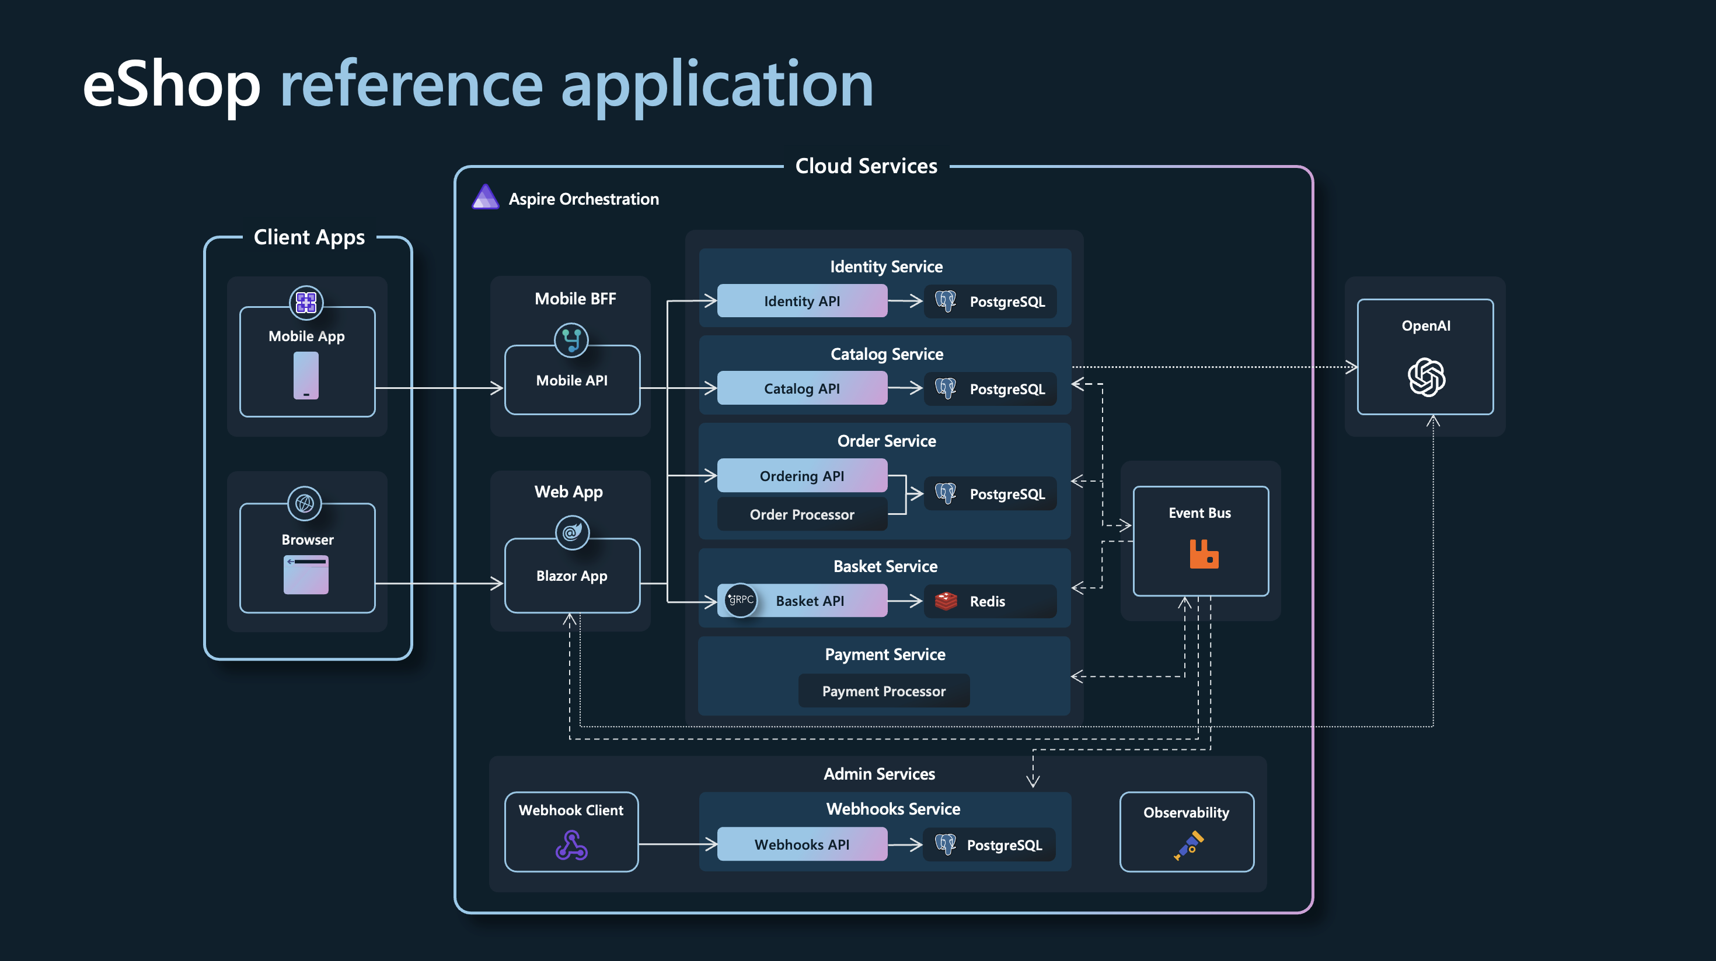
.NET MAUI
Showcases
https://github.com/dotnet/eShop

Slide 52
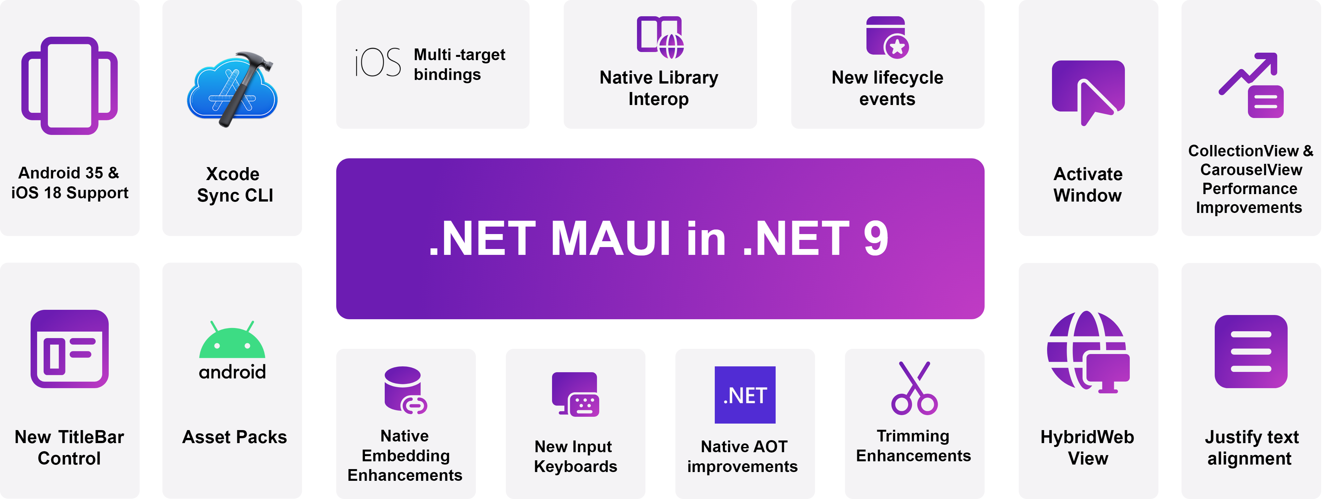
.NET MAUI
Spoiler
Source
Notes:
HybridWebView – Reuse all components from ReactJS, Angular Views, and any JavaScript libraries

Slide 53

Entity Framework Core 8
…

Slide 54
EF Core 8
Value objects using Complex Types
[ComplexType]
public class Address
{
public required string Line1 { get; set; }
public required string City { get; set; }
...
}
protected override void OnModelCreating(ModelBuilder modelBuilder)
{
modelBuilder.Entity<Customer>()
.ComplexProperty(e => e.Address);
...
}
public class Customer
{
...
public required Address Address { get; set; }
...
}
CREATE TABLE "Customers" (
...
"Address_City" TEXT NOT NULL,
"Address_Line1" TEXT NOT NULL,
...
)

Slide 55
EF Core 8
Value objects using Complex Types
Reference types as complex types
Immutable class
Immutable record
Value types as complex types
Mutable struct
Immutable struct
Immutable struct record
Nested complex types
Current limitations:
Support collections of complex types.
Allow complex type properties to be null.
Map complex type properties to JSON columns.
Constructor injection for complex types.
Add seed data support for complex types.
Map complex type properties for the Cosmos provider.
Implement complex types for the in-memory database.

Slide 56
EF Core 8
JSON columns
public class Author
{
...
public Contact Contact { get; set; }
}
public class Contact
{
...
public Address Address { get; set; }
}
public class Address
{
...
}
protected override void
OnModelCreating(ModelBuilder modelBuilder)
{
modelBuilder.Entity<Author>()
.OwnsOne(
author => author.Contact,
ownedNavigationBuilder =>
{
ownedNavigationBuilder.ToJson();
ownedNavigationBuilder
.OwnsOne(contact => contact.Address);
});
...
}

Slide 57
EF Core 8
JSON columns
Introduced in EF Core 7
EF Core 8 supports:
Primitive collections in JSON documents
Translate element access into JSON arrays
Translate queries into embedded collections
JSON Columns for SQLite
Id | Name | Contact
1 | Maddy Montaquila | { "Phone":"01632 12345", "Address": { "City":"Camberwick Green", "Country":"UK", "Postcode":"CW1 5ZH", "Street":"1 Main St" } }
… | … | …

Slide 58
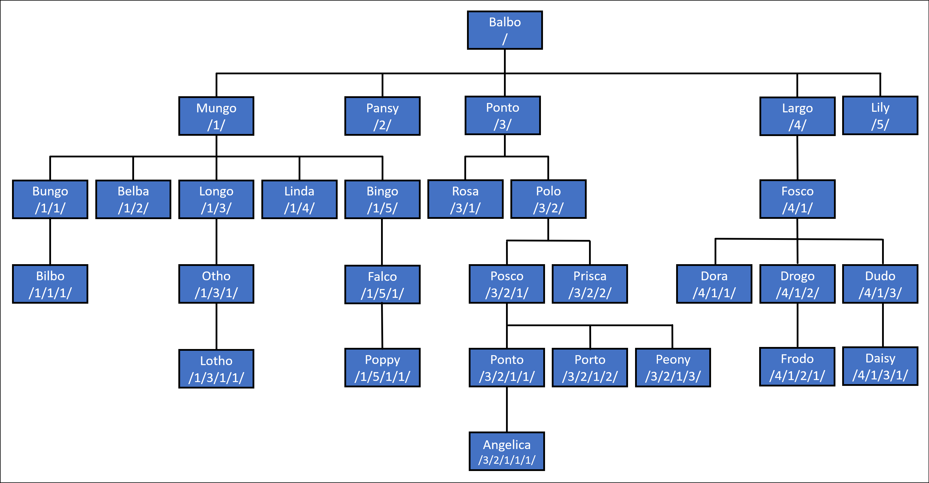
EF Core 8
HierarchyId

Slide 59
EF Core 8
HierarchyId
public class Halfling
{
...
public int Id { get; private set; }
public HierarchyId PathFromPatriarch { get; set; }
public string Name { get; set; }
public int? YearOfBirth { get; set; }
}
protected override void OnConfiguring(DbContextOptionsBuilder options)
=> options.UseSqlServer(ConnectionString, x => x.UseHierarchyId());

Slide 60
EF Core 8
HierarchyId
var thirdGeneration = await db.Halflings
.Where(halfling => halfling.PathFromPatriarch.GetLevel() == 2)
.ToListAsync(); // Bungo, Belba, Longo, Linda, Bingo, Rosa, Polo, Fosco
var directAncestor = await db.Halflings
.SingleOrDefaultAsync(
ancestor => ancestor.PathFromPatriarch == db.Halflings
.Single(descendent => descendent.Name == "Bilbo").PathFromPatriarch
.GetAncestor(1)); // Bungo
var directDescendents = await db.Halflings
.Where(descendent => descendent.PathFromPatriarch.GetAncestor(1) == db.Halflings
.Single(ancestor => ancestor.Name == "Mungo").PathFromPatriarch)
.ToListAsync(); // Bungo, Belba, Longo, Linda, Bingo

Slide 61
EF Core 8
Raw SQL queries
CREATE TABLE [Posts] (
[Id] int NOT NULL IDENTITY,
[Title] nvarchar(max) NOT NULL,
[Content] nvarchar(max) NOT NULL,
[PublishedOn] date NOT NULL,
[BlogId] int NOT NULL,
);
public class BlogPost
{
public int Id { get; private set; }
[Column("Title")]
public string BlogTitle { get; set; }
public string Content { get; set; }
public DateOnly PublishedOn { get; set; }
public int BlogId { get; set; }
}

Slide 62
EF Core 8
Raw SQL queries
var start = new DateOnly(2022, 1, 1);
var end = new DateOnly(2023, 1, 1);
var postsIn2022 =
await context.Database
.SqlQuery<BlogPost>(
$"SELECT * FROM Posts as p WHERE p.PublishedOn >= {start}
AND p.PublishedOn < {end}")
.ToListAsync();
Console.WriteLine(postsIn2022.All(p => p.PublishedOn.Year == 2022)); // true

Slide 63
EF Core 8
Raw SQL queries
Introduced in EF Core 7, only supported returning scalar types
SqlQuery or SqlQueryRaw
No DbSet<T> needed!
EF Core 8 supports returning any mappable CLR type
Stored procedures supported

Slide 64
EF Core 8
Sentinel values and database defaults
public class Person
{
public int Id { get; set; }
public int OverdraftCredit { get; set; }
}
...
modelBuilder.Entity<Person>(b =>
{
b.Property(e => e.OverdraftCredit).HasDefaultValue(500);
});

Slide 65
EF Core 8
Sentinel values and database defaults
var person = new Person
{
Id = 1,
OverdraftCredit = 0
};
context.Add(person);
await context.SaveChangesAsync();
Console.WriteLine(person.OverdraftCredit); // Result: 500
Notes:
Inserting a record with zero credits is not possible, since zero is the CLR default

Slide 66
EF Core 8
Sentinel values and database defaults
modelBuilder.Entity<Person>(b =>
{
b.Property(e => e.OverdraftCredit).HasDefaultValue(500).HasSentinel(-1);
});
...
public class Person
{
public int Id { get; set; }
public int OverdraftCredit { get; set; } = -1;
}

Slide 67
EF Core 8
Sentinel values and database defaults
var person = new Person
{
Id = 1,
OverdraftCredit = 0
};
context.Add(person);
await context.SaveChangesAsync();
Console.WriteLine(person.OverdraftCredit); // Result: 0

Slide 68
EF Core 8
Summary
Value objects using Complex Types
JSON columns
HierarchyId in SQL Server
Raw SQL queries for unmapped types
Sentinel values and database defaults
DateOnly/TimeOnly supported on SQL Server
…
Notes:
The DateOnly and TimeOnly types were introduced in .NET 6 and have been supported for several database providers (e.g. SQLite, MySQL, and PostgreSQL) since their introduction.

Slide 69
Q&A
Live Coding

Slide 70
Important Features
*Imho*
.NET Runtime: NativeAOT*, System.Text.Json, Frozen collections, Time abstraction
.NET SDK: Artifacts output layout
C# 12: Primary constructors, collection expressions
.NET Aspire: .NET 9
ASP .NET Core: Keyed DI Services, Debugger improvement
MinimalAPIs: CreateSlimBuilder
Blazor: Web App, Hybrid
MAUI: enterprise application feasible
EF Core 8: Complex Types, DateOnly/TimeOnly supported

Slide 71
What‘s next?
References
What's new in .NET 8 | Microsoft Learn
Breaking changes in .NET 8 | Microsoft Learn
Performance Improvements in .NET 8 | Stephen Toub
What's new in .NET 9 | Microsoft Learn

